Slide 1
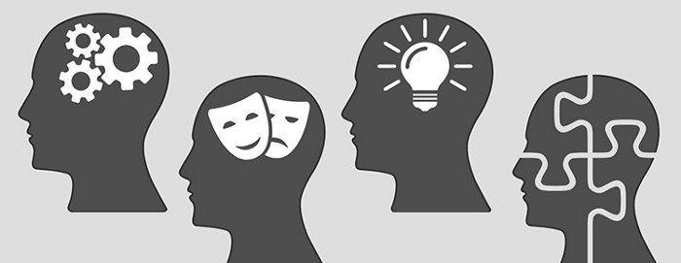
Myers-Briggs Personality Prediction
Sujata Gorai (HC6837 )
Nalisha Rathod (GS9440)

Slide 2
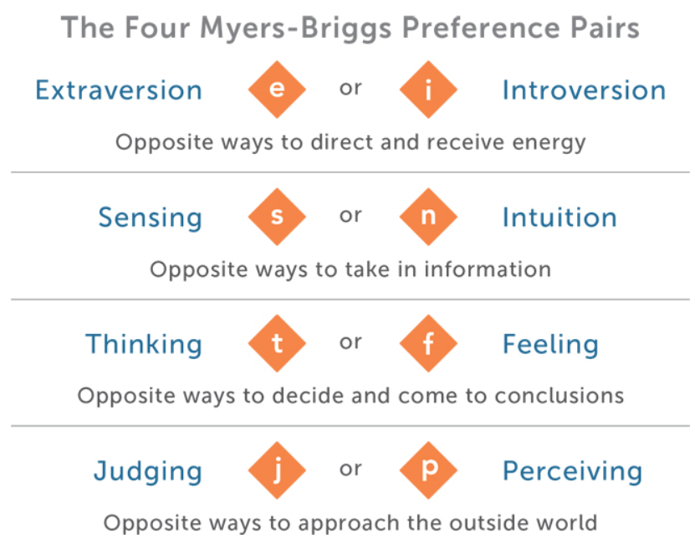
Introduction
MBTI is a personality metric developed by Katharine Cook Briggs and Isabel Briggs Myers
Each person would be typed with 4 letters according to MBTI.
For someone, whose type is ENFJ, this means that this person is Extraverted, Intuitive, Feeling and Judging. All combination of these 4 letters gives us 16 unique personalities.
Common way of finding out MBTI type is through personality test websites. Sometimes the answers are biased and thus the person is wrongly classified.
Our project will try to find out the MBTI types for a person through their posts

Slide 3
Related Work
Machine Learning Approach to Personality Type Prediction Based on the Myers–Briggs Type Indicator - Mohammad Hossein Amirhosseini * and Hassan Kazemian
Personality prediction of Twitter users with Logistic Regression Classifier learned using Stochastic Gradient Descent - Journals Iosr, Sharma Kanupriya, Kaur Amanpreet
Predicting Myers-Briggs Type Indicator with Text Classification – Rayne Hernandez and Ian Scott Knight.
Predicting MBTI Personality type with K-means Clustering and Gradient Boosting - Zeeshan Mushtaq, Sagar Ashraf and Nosheen Sabahat
LONG SHORT-TERM MEMORY - Sepp Hochreiter and Jurgen Schmidhuber

Slide 4
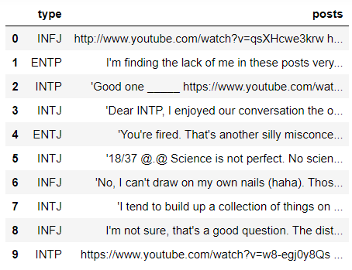
About the Dataset
The data is forum posts, originally from personalitycafe.com. The dataset is available in Kaggle - https://www.kaggle.com/datasnaek/mbti-type
The dataset has 8675 data. It only has 2 columns MBTI Types and Posts
Types – Class or type of MBTI personality – e.g. INFP, INFJ, ENTP,ESTJ etc.
There are 50 different posts from a single person in each row all separated by ||| (3 pipe characters). Posts consist of Texts as well as URL , emoticons, hashtags(#) and Mentions (@)
Above are the first 10 rows of data with Personality types and Posts

Slide 5
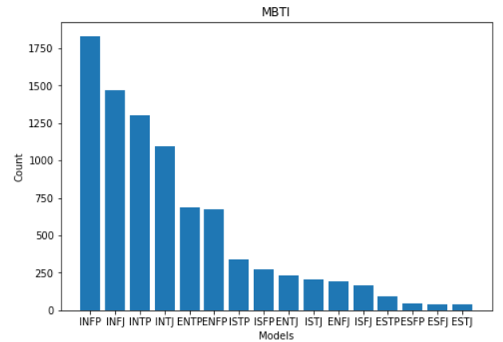
Dataset Visualization
The data is highly imbalanced – INFP has more than 1750 data but ESTJ has only 39.

Slide 6
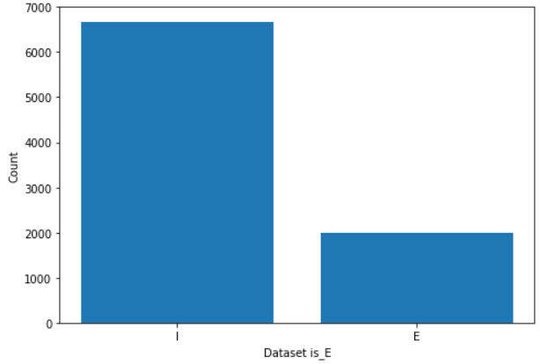
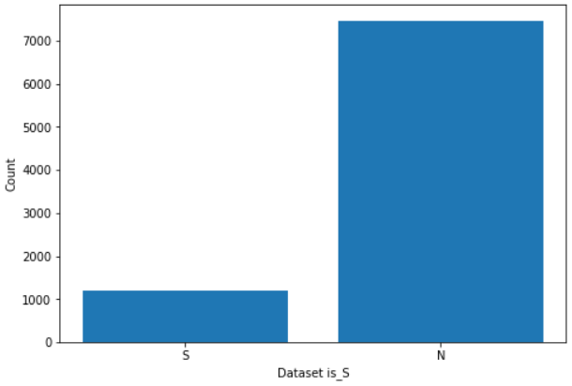
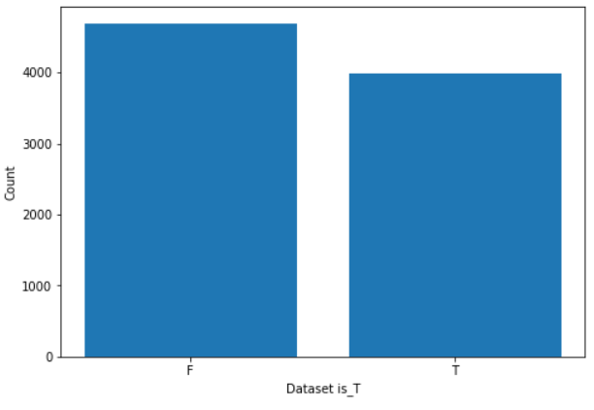
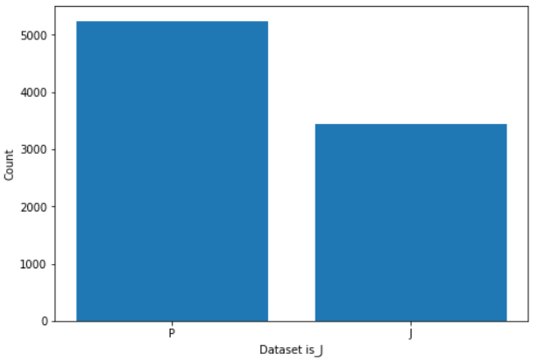
Data Preprocessing
As the data is imbalanced, we decided to reclassify the data into 4 Major category instead of 16:
Extraversion/Introversion as is_E
Sensing/Intuition as is_S
Thinking/Feeling as is_T
Judging/Perceiving as is_J
Each of them will have the same number of data i.e. 8675
For E.g. if the personality type was ISFJ we re-classify it for the 4 different category dataset as :
I will be assigned to dataset is_E and Class as 0
S will be assigned to dataset is_S and Class as 1
F will be assigned to dataset is_T and Class as 0
J will be assigned to dataset is_J and Class as 1
There is still imbalance in the data mainly for is_E and is_S . But the is_T and is_J is almost balanced.

Slide 7
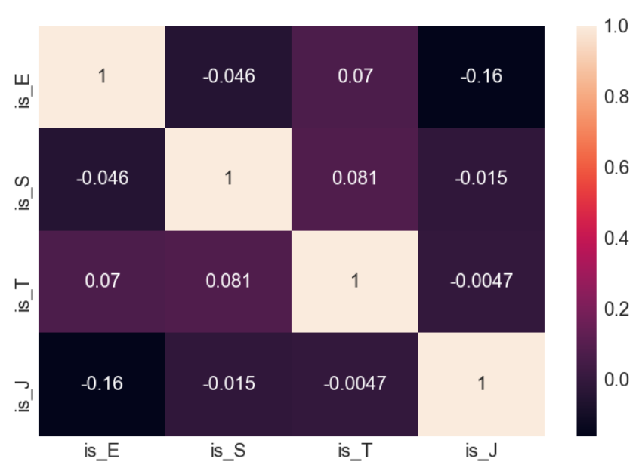
Data Preprocessing
This is the correlation plot for the 4 new personality types
As we can observe that most of the values are very low and close to 0. So, we can confirm that they are not highly correlated and independent of each other.
We would be testing the difference in behavior of the balanced and the unbalanced class.
Is_E is selected as the unbalanced
Is_T is selected as the balanced

Slide 8
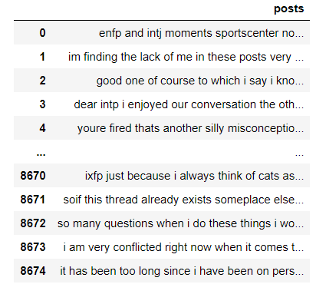
Data Cleaning and Preprocessing
Remove the URL, Hashtags, Emoticons, words containing numbers and Mentions
Made the text into lowercase
Remove punctuations
Remove Stop word – added the 16 MBTI types that are mentioned
Tokenized the data
Vectorization – Word Embeddings
Word2Vec
GloVe
FastText

Slide 9

Machine Learning Models
Support Vector Machine
Logistic Regression
XGBoost

Slide 10
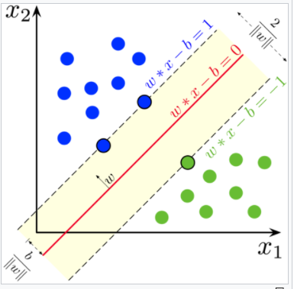
Support Vector Machine
A support vector machine (SVM) is a supervised machine learning model that uses classification algorithms for two-group classification problems.
Implementation:
Vectorized training dataset was fed as input into the SGDClassifier model
Optimizer - Stochastic Gradient Descent
Loss - hinge
5-fold cross-validation technique was used to determine the training accuracy score.

Slide 11
Logistic Regression
Logistic regression is a classification algorithm used to solve binary classification problems. The classifier uses the weighted combination of the input features and passes them through a sigmoid function. Sigmoid function transforms any real number input, to a number between 0 and 1.
Implementation:
Vectorized training dataset was fed as input into the Logistic Regression classification model
Optimizer - Stochastic Average Gradient descent(sag)
5-fold cross-validation technique was used to determine the training accuracy score.

Slide 12
XGBoost (XGB) stands for eXtreme Gradient Boosting is an implementation of gradient boosting machines that pushes the limits of computing power for boosted trees algorithms as it was built and developed for the sole purpose of model performance and computational speed.
Implementation:
Created a python function for XGBoost with following parameters:
‘booster’ is set to gbtree
‘eta’ or the learning rate is set to 0.1.
’max depth’ is set to 6
‘min child weight’ is set to 1
‘subsample’ (subsample ratio of the training instances) is set to 0.7
‘colsample bytree’ (subsample ratio of columns when constructing each tree) is set to 0.7
’objective’ (learning objective) is set to binary logistic
Number of rounds as 500
Early stopping as 20
XGBoost - eXtreme Gradient Boosting

Slide 13
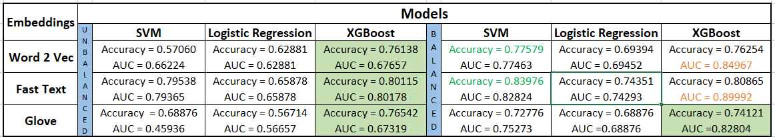
Results with Machine Learning Models

Slide 14
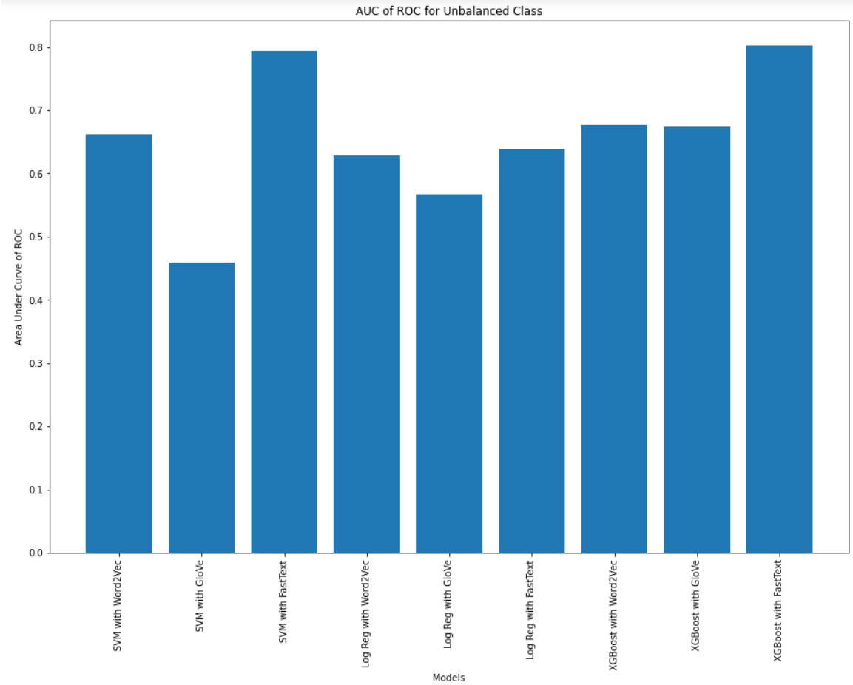
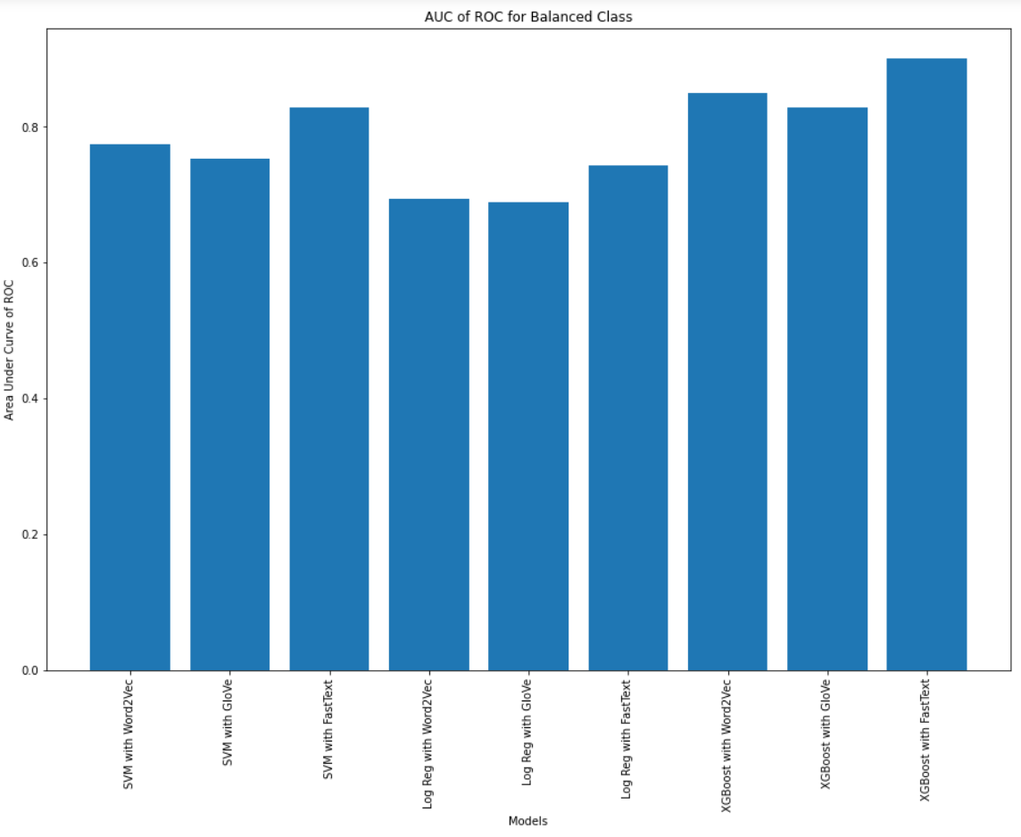
Visualizing the Results

Slide 15

Deep Learning Models
We have used three deep neural network models to perform our tasks.
The models are :
1) Long Short-Term Memory (LSTM) with Dropout
2) Bidirectional Gated Recurrent Unit(GRU)
3) Pooled Gated Recurrent Unit(GRU)

Slide 16
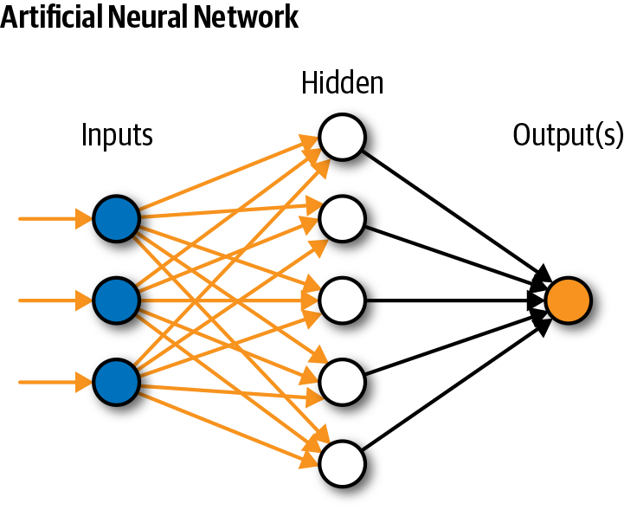
What is Deep Learning ?
Deep learning is subset of Machine Learning.
Structure inspired by human brain.
It is used in Natural Language Processing, Visual Recognition, Fraud Detection.
It describes certain types of Neural networks.

Slide 17

Long Short-Term Memory (LSTM)
To reduce the problem with long term dependencies in Recurrent Neural Network (RNN).
Drawbacks of RNN
For example : 1) The sky is _______ (this can we predicted by RNN)
2) Recurrent neural networks (RNN) are the state-of-the-art algorithm for sequential data and are used by Apple’s _________(this cannot be predicted by RNN)
LSTM consists of 3 units: Input Gate, Forget Gate and Output Gate.

Slide 18
LSTM Pre-Processing
glove.840B.300d for word embedding in this model
dropout layer - reduce the overfitting problem
Parameters used are
-embed size = 50 ( how big is each word vector) -max features = 20000 (how many unique words to use) (i.e num rows in embedding vector) -maxlen = 100
Prepossessed the data with padding and tokenization
We have used loss=‘binary crossentropy’ optimizer=‘adam’ metrics=[‘accuracy’].

Slide 19
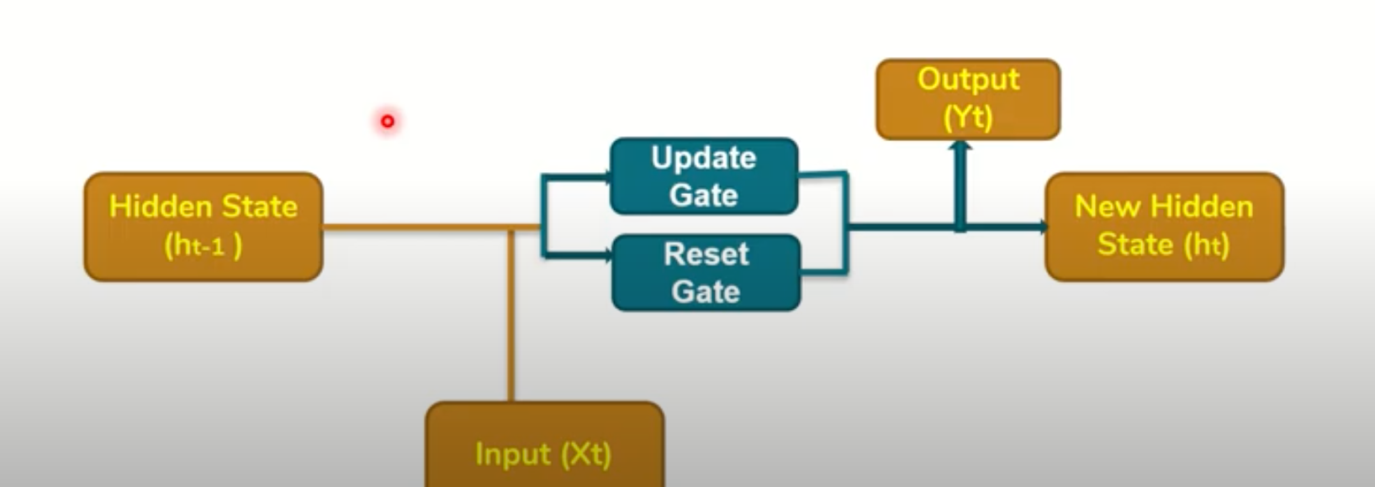
Bidirectional Gated Recurrent Unit (GRU)
GRU’s are a modifications to RNN.
It utilizes the Gate mechanism same as LTSM to manage and control the flow of information between the cells in the NN.
It has two gates Update gate and Reset Gate

Slide 20
Bidirectional GRU Pre-Processing
glove.840B.300d for word embedding in this model
dropout layer - reduce the overfitting problem
Parameters used are
max features=100000 (maximumfeatures)
maxlen=150 (maximum length) embed size=300 (size of embedding)
Prepossessed the data with padding and tokenization then convert it vector by using word embeddings.
Set two pooling layers (average pooling and max pooling) layer after bidirectional GRU layer
set dense layer
batch size = 32 and number of epochs = 2
We have used loss=‘binary crossentropy’ optimizer=‘adam’ metrics=[‘accuracy’].

Slide 21
Pooled Gated Recurrent Unit (GRU)
It is a simple GRU.
It has Pooling Layers- > Pooling Layers are used to reduce the dimensions of the feature matrix.
Therefore, it reduces the number of parameters to learn, and the amount of computation performed in the network.

Slide 22
Pooled GRU Pre-Processing
FastText 300d for word embedding in this model
dropout layer - reduce the overfitting problem
Parameters used are
max features=30000 (maximumfeatures)
maxlen=100 (maximum length) embed size=300 (size of embedding)
Prepossessed the data with padding and tokenization then convert it vector by using word embeddings.
Set two pooling layers (average pooling and max pooling) layer after bidirectional GRU layer
set dense layer
batch size = 32 and number of epochs = 2
We have used loss=‘binary crossentropy’ optimizer=‘adam’ metrics=[‘accuracy’].

Slide 23
Deep Learning Model Evaluation
Unbalanced Class
Balanced Class
Models | Accuracy
LSTM(GLOVE) | Accuracy = 0.645 AUC = 0.575
Bidrectional GRU(GLOVE) | Accuracy =0.4566 AUC = 0.547833
Pooled GRU(FASTEXT) | Accuracy = 0.6357 AUC = 0.473
Models | Accuracy
LSTM(GLOVE) | Accuracy =0.7502 AUC = 0.793777
Bidrectional GRU(GLOVE) | Accuracy = 0.6946 AUC = 0.778512
Pooled GRU(FASTEXT) | Accuracy = 0.7469 AUC = 0.772884

Slide 24
is_S class- (balanced) (using oversampling)

Slide 25
Loss Calculation
S_class(imbalanced)
T_class(balanced)
S_class (balanced)

Slide 26
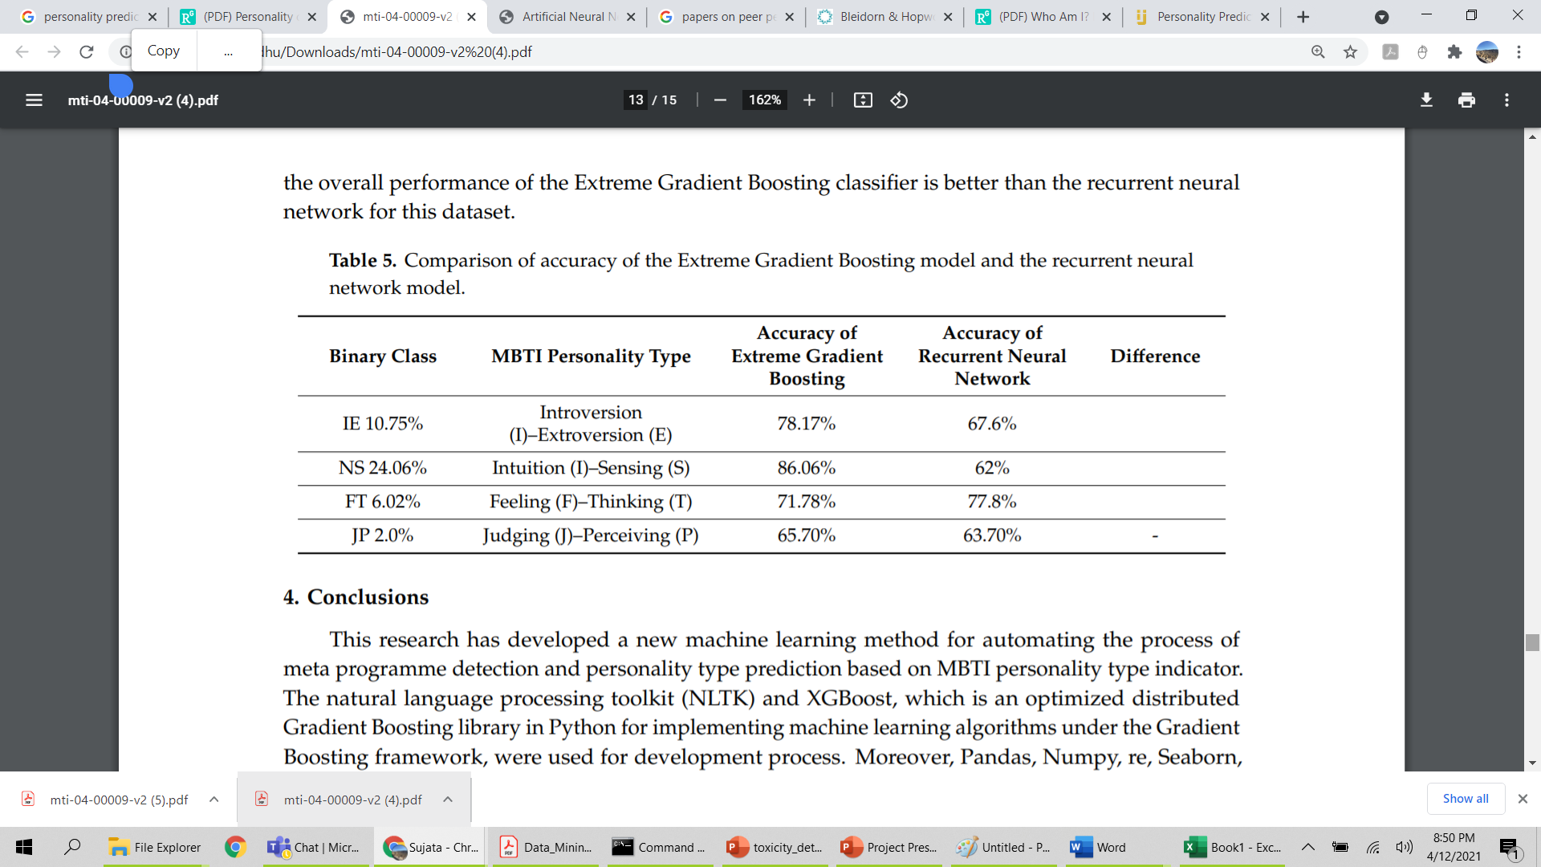
Conclusion
XGBoost
Our Model
U N B A L A N C E D
XGBoost
Accuracy = 0.76138 AUC = 0.67657(Word2Vec)
Accuracy = 0.80115 AUC = 0.80178(FastText)
Accuracy = 0.76542 AUC = 0.67319(Glove)
B A L A N C E D
XGBoost
Accuracy = 0.76254 AUC = 0.84967
Accuracy = 0.80865 AUC = 0.89992
Accuracy = 0.74121 AUC =0.82804
Machine Learning Approach to Personality Type Prediction Based on the Myers–Briggs Type Indicator®
- Mohammad Hossein Amirhosseini * and Hassan Kazemian

Slide 27
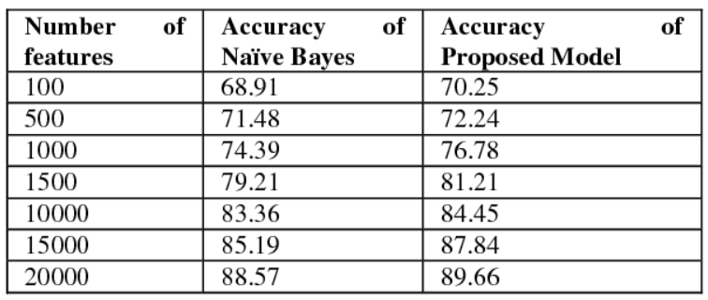
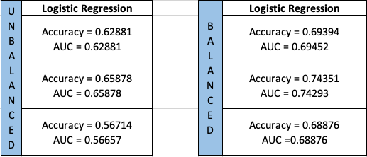
Conclusion
Logistic Regression
Our Model
Personality prediction of Twitter users with Logistic Regression Classifier learned using Stochastic Gradient Descent
In sequence Word2Vec, FastText ,Glove

Slide 28
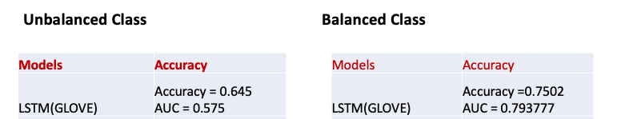

Deep Learning
Pooled GRU (balanced class after over sampling)

Slide 29

Conclusion
With the evaluation of both the Deep Learning and Machine Learning Models we have concluded that XGBoost gives the best accuracy of 0.899% with FastText word embedding
LSTM also gives us better accuracy of about 0.80% with Glove embedding for balanced class and Pooled GRU gives about 75% of accuracy after over-sampling the unbalanced class.
With balanced dataset we get much better accuracy overall.

Slide 30
Future Work
1)Apply various other classification model to this dataset and to the new domain of Data.
2)Trying to make the dataset balanced using different techniques.
3)Working on all the 16 personalities and trying to evaluate the results .
4)Modify the preprocessing techniques.

Slide 31


Thank you

